Slide 1

Mastering the Art of Adopting R and Python: Innovative Strategies for Effective Change Management
Mark Bynens
August 2024
Notes:
"Hi there! If you're here for 'Change Management 101,' you're in the right place. If you're here for 'How to Win the Lottery,’ good, it’s the same thing.

Slide 2

The opinions expressed are those of the authors and do not necessarily represent the opinions of POSIT, respective companies or organizations, or the products’ respective companies mentioned.
It is the reader's responsibility to determine if and how change management would best suit their need.
Additionally, the authors do not endorse any specific commercial products or services.
Notes:
First a disclaimer: these are my opinions, it’s your responsibility what you do with it and I’m not endorsing any specific products or services.

Slide 3
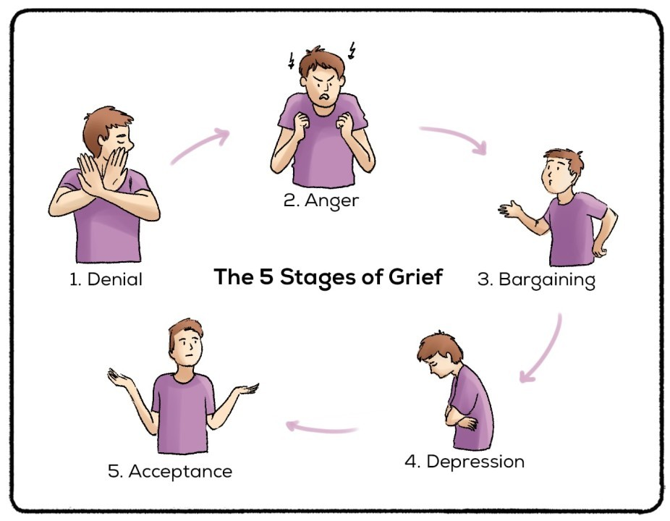
The Five Stages of Grief
Resource:: https://www.rarebookcellar.com/pages/books/181481/elisabeth-kubler-ross/on-death-and-dying
Notes:
What you see here on this slide are the 5 stages of grief, introduced by psychiatrist Elisabeth Kubler-Ross in her book On Death and Dying. These stages represent the emotional journey individuals experience when faced with a life-changing or tragic event. At J&J we have been using SAS, a statistical analysis software, for years … Not that this is a tragic event but imagine telling a room full of seasoned statistical programmers and statisticians who have relied on SAS for the past 15 years, and telling them they need to switch from their beloved SAS to R and/or Python (open-source). The response? Surprisingly similar as these 5 stages! They navigated through: Denial (‘This can't be true. SAS is so established and reliable.’) Anger ('This is a waste of time and resources. I’m proficient in SAS, and now I have to start over with these new tools!’) Bargaining ('Can we just keep using SAS for some tasks?’),
Depression ('I’ll never be as good with R and Python as I am with SAS.'), and finally,
Acceptance ('Learning these new tools could actually broaden my skillset and open up new opportunities.’).
During this presentation I will explain how Change management can significantly help individuals and organizations navigate these emotional stages of change.

Slide 4
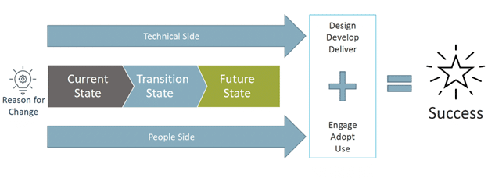
Successful change
Requires both technical and people sides
Design
Develop
Deliver
Plan
Implement
Sustain
Resource: https://stoneridgesoftware.com/6-ways-organizational-change-management-ensures-your-project-delivers-on-its-promise/
Notes:
How does succesful change look like? Successful change requires both a technical and a people sides. And technical can also mean process change not only technology.
Just delivering on the technical side doesn’t cut it. People neeed to embrace, adopt and use the future state for it to be successfully implemented.
Nicole talk more about a technical side of change, I’m going to talk more about the people side of change where I will use the transition from a well established programming language SAS to R as a real world example. The strategies explained can off course be applied to other lanaguages, changes as well. And as we are about to talk about the people side of change your greatest adversary is not that change is hard to make your greatest adversary is common sense which I will demonstrate by debunking a myth around change.

Slide 5
Help is on the way
Change Management
PHASE
01
PHASE
02
PHASE
03
PLAN
IMPLEMENT
SUSTAIN
Notes:
To effectively manage change, we can break the process into three key phases: Plan, Implement, and Sustain.
In the Plan phase, we start defining the change, understanding the potential impact of the change, and creating a detailed strategy to guide the process.
During the Implement phase, we put this plan into action, ensuring that everyone is kept informed, providing the necessary support to help people adapt to the changes and we monitor progress to make sure everything is on track
Finally, in the Sustain phase, reinforce the new behaviors and processes, and make any necessary adjustments to ensure the changes are lasting and effective.

Slide 6
Help is on the way
Change Management
PHASE
01
PHASE
02
PHASE
03
PLAN
IMPLEMENT
SUSTAIN
Notes:
Let's discuss the planning phase. This is such a crucial step that we often don't give it the thorough attention it deserves—we usually just plan for some training, for example. So, I'm going to spend a bit more time on this one.

Slide 7
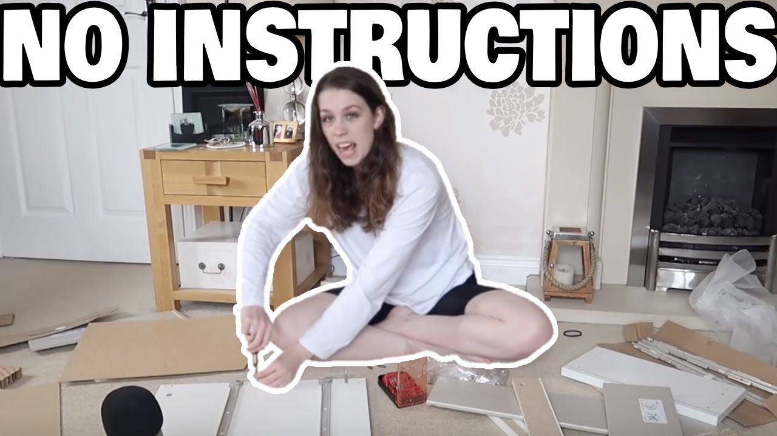
Plan for change
Resource:
https://www.youtube.com/watch?v=E6eglsMR8Io
Notes:
Why plan for change? Have you ever tried to assemble IKEA furniture without instructions? It's like embarking on a heroic quest, armed only with an Allen wrench, screwdriver and a vague sense of optimism. You start confident, convinced you don't need the manual, only to find yourself an hour later with a mysterious pile of extra screws, a lopsided bookcase, and a sinking feeling that something's terribly wrong. Planning the change management phase is crucial because, much like writing those IKEA instructions for others (and hopefully even better than those IKEA instructions), it helps them avoid ending up with a wonky outcome and instead ensures everything fits together perfectly from the start. And with a bonus that most working relationships will stay intact.
So, before you launch an new software or process please make sure to prepare well for that launch by planning that change. Just providing training is not enough!!

Slide 8
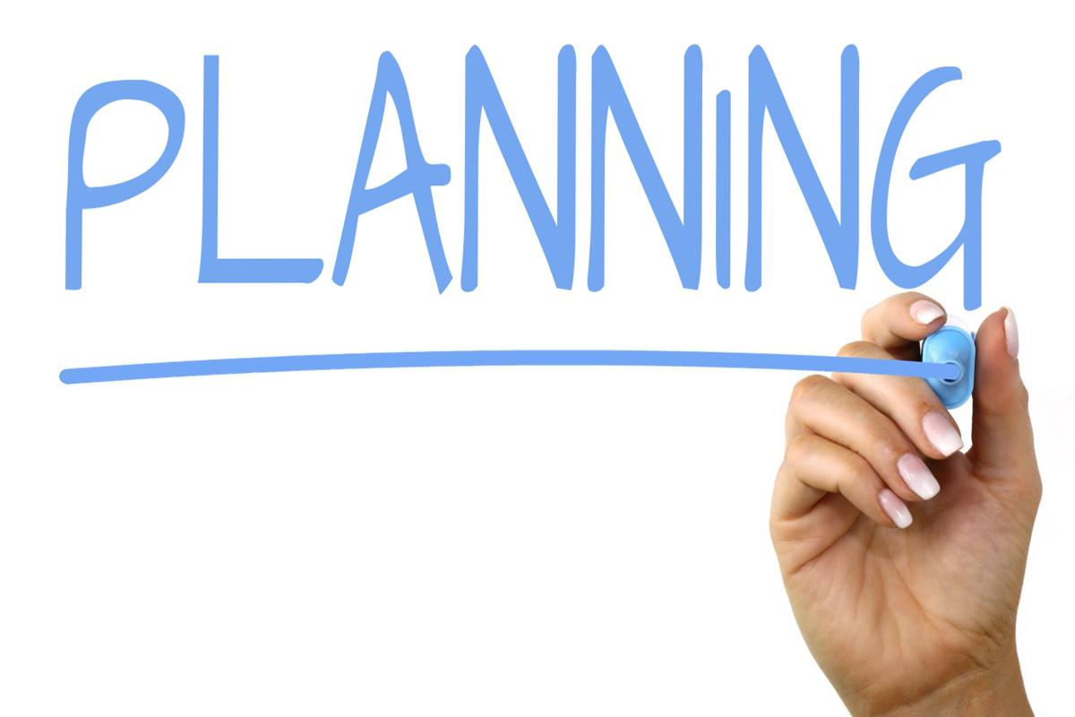
Plan for change
Steps
Define the change (What?)
Identify the key stakeholders (Who?)
Assess the impact of the change (Implications? – Why?)
Develop strategies for managing resistance (Concerns?)
Create a timeline for implementation (When?)
Resource:
https://www.toppr.com/guides/business-studies/planning/types-of-plan/
Notes:
In planning for change I will go over 5 steps, let’s get started with the first one: defining the change. The what?

Slide 9
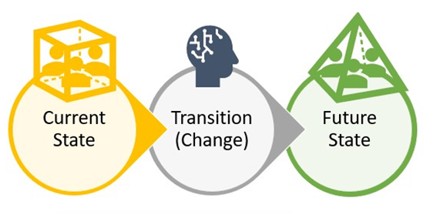
1. Define the Change (What?)
What are the things we used to be able to do and still can?
What are the things we couldn’t do before and still can’t do?
What are the things we could do before and can’t do now?
What are the things we couldn’t do before but can now?
Resource:
https://www.ocmsolution.com/change-management-definition/
Notes:
In defining the change, we clearly outline the current state, the desired future state, and the reasons for the transition
In defining the future state, 4 key questions to get to know how big the change really is can really help:
- What are the things we used to be able to do and still can? -> business as usual
- What are the things we couldn’t do before and still can’t do? -> business as usual
- What are the things we could do before and can’t do now? -> let it go
What are the things we couldn’t do before but can now? -> go for it
These questions will calm down people.
Without a clear definition, there is room for ambiguity, which can lead to resistance, confusion, or inefficient use of resources.

Slide 10
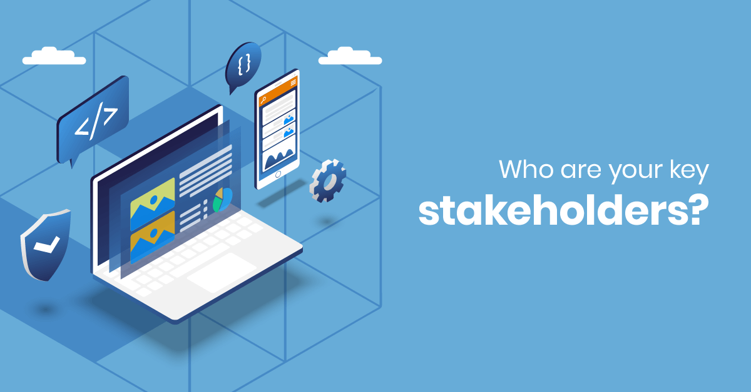
2. Identify the Key Stakeholders (Who?)
The four key stakeholder groups in any change are:
The change initiators ‘above’ the change
The change partners ‘on’ the change
The change recipients ‘in’ the change (journey)
The interested onlookers ‘around’ the change
Resource:
https://www.efrontlearning.com/blog/2019/11/key-stakeholders-in-online-training.html
Notes:
Next step is identifing all individuals, groups, or entities who will be affected by, can influence, or have an interest in the proposed change
Divide the key stakeholders up into groups according to their relationship to the change.
The four key stakeholder groups in any change are:
The change initiators ‘above’ the change
The change partners ‘on’ the change
The change recipients ‘in’ the change (journey)
The interested onlookers ‘around’ the change
Identifying stakeholders is an ongoing process: you might have to make more subdivisions over time.
Example for change recipients is to divide the group of statisticians further into who knows already how to use R and who doesn’t?

Slide 11
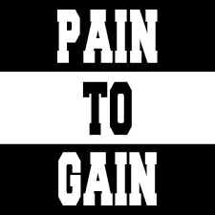

3. Assess the Impact of Change (Implications? – Why?)
At its heart lie precise 'what's in it for me' (WIIFM) statements tailored uniquely for each stakeholder.
Resource:
https://change.walkme.com/defining-change-impact/
Notes:
The 3rd step in planning for change is assessing the impact of change. It’s not about producing widgets or features or checking off tasks. It's about achieving the desired results.
It’s about behavioral change, it’s about outcomes. Pain to gain looks at it more from an emotional perspective rather then a technical one: what am I gaining here?
At its heart we need to answer, 'what's in it for me' (WIIFM) uniquely for each stakeholder.
Example: Using R, a statistician can access a wider range of advanced statistical packages and libraries not available in SAS. Giving him Access to Cutting-Edge Methods. From the statistician's perspective, the transition to R becomes more appealing and relevant to their professional goals and daily work.

Slide 12

4. Develop Strategies for Managing Resistance (Concerns?)
Addressing this resistance is crucial, as unaddressed concerns can stagnate or even derail the implementation process
Resources:
https://primeast.com/us/insights/leadership-development/7-strategies-for-overcoming-resistance-to-change-in-the-workplace
https://inview.lawvu.com/blog/resistors-to-change-hold-gold-nuggets-of-wisdom
Notes:
The 4th step: developing strategies for managing resistance.
When people say “We have always done it this way and it works just fine" they are often expressing a variety of underlying sentiments and perceptions:
They have a sense of loss of control.
Uncertainty
Fear of failure.
Doubts that it will work, perhaps due to past failures.
They don’t see a problem with the current process.
Low trust that the change will be managed effectively.
People resist to change for many reasons and addressing this resistance is crucial, as unaddressed concerns can stagnate or even derail the implementation process.
Some examples that can help with resistance are:
Put a support Team or SME in place
Let folks experience the change via Pilot Projects and a Gradual Transition
Put an escalation process in place as some concerns are to be listened to and exceptions might need to be granted.
These strategies can help address concerns, build competence, and create a more receptive environment for the change.

Slide 13

Myth: Education will change behavior
Notes:
Before we go the last step of planning, I would like to debunk the myth that education (with training and information) will change behavior. Where common sense leads us astray. We think if we're going to change people's behavior, they just need education. If we just give them some information, then they'll change their behavior. Nope. The actions and opinions of others, called social norms, influence our own behavior to the greatest extent. Street musicians know this trick: they put coins and money in their cases to encourage donations. However just putting money in their case isn’t enough. The real key is having a friend drop a dollar in every five minutes. The number one predictor of giving money to a street musician is walking past the musician directly behind someone who did contribute.
An example in the case of transition from SAS to R is a senior programmer who starts using R and shares his/her positive experiences and successes with the team.
So, the actions and opinions of others, called social norms, influence our own behavior to the greatest extent.

Slide 14
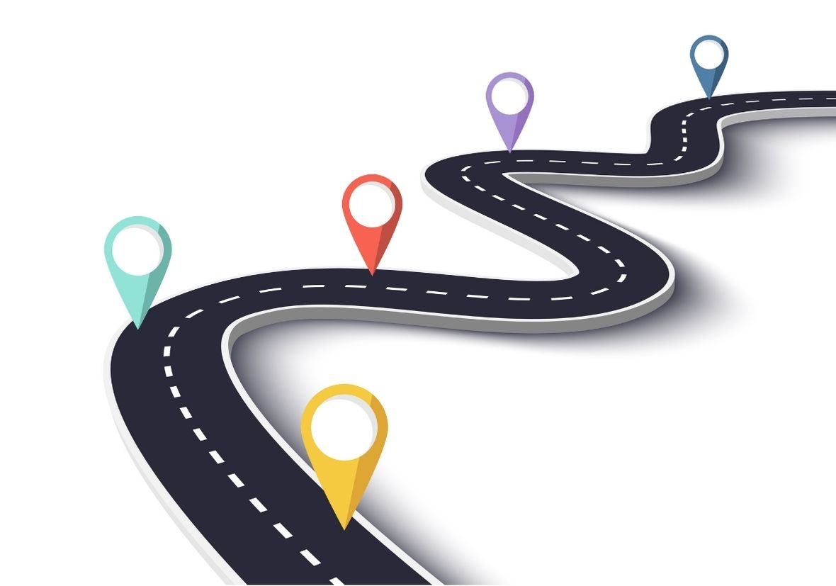
5. Create a Timeline for Implementation (When?)
Serves as a chronological roadmap, delineating the sequence of events, milestones, and tasks essential for the successful realization of the desired change.
Resource:
https://hrfibreglass.co.uk/grp/why-you-need-a-business-roadmap/
Notes:
The 5th at last step of planning for change is creating a timeline for implementation which answers the question When? around the change: including key milestones and tasks essential for the successfull realization of the desired change.
It provides a clear structure, ensuring that all stakeholders understand their roles, responsibilities, and the behavioral expectations placed upon them at various stages of the transformation.

Slide 15
Help is on the way
Change Management
PHASE
01
PHASE
02
PHASE
03
PLAN
IMPLEMENT
SUSTAIN

Slide 16
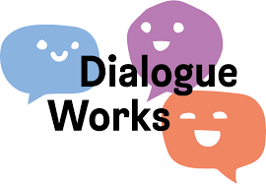
Implementing Change
Communication – Monitoring - Support
When implementing change:
Effective and clear communication is key
Important to monitor and evaluate the results of the monitoirng
Make sure to have enough support available for the change recipients
Resource:
https://elearningat.work/product_detail/4
Notes:
When implementing change:
Effective and clear communication is key:
Be honest and transparent: give also bad news, don’t try to sugar coat it or not mention it.
Use multiple channels of communication: yammer, email, meetings,
It’s a 2 way street, an ongoing dialogue instead of top down communciation. You have to talk a lot with all different groups of stakeholders and take the time to do so formally as well as informally.
In order to see how the change is progressing it is important to monitor and evaluate the results of the monitoring. Once we have to results of the monitoring process we need to do an interpretation and evaluation to better understand what the results actually mean. This understanding might lead to adjustments or specific actions to be taken.
And besides communication and monitoring the change, be sure to provide plenty of support for the people who will be affected by the change during the implementation phase.

Slide 17
Help is on the way
Change Management
PHASE
01
PHASE
02
PHASE
03
PLAN
IMPLEMENT
SUSTAIN

Slide 18
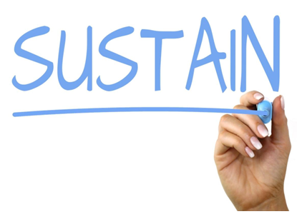
Sustaining Change
Change is not a one-time event, it’s an ongoing process
Resource:
https://blogs.mtu.edu/improvement/2018/08/03/sustaining-improvement
Notes:
Change is not a one-time event, it’s an ongoing process. Sustaining change is also a crucial step to successful change management. How to sustain change:
Let people take the change and own it.
Provide ongoing training and support to employees
Be flexible and willing to make adjustments to the change plan as needed, making continuous improvements.
Tell the success stories and reward people for it!
Be patient, persistent, transparent and honest: constant check-ins and communication using a variety of formal and informal methods. Communicating the good with the bad.

Slide 19







Branding and Infusing Fun
To make the process more engaging, memorable and effective
Notes:
Finally, I would like to talk about branding and infusing fun. Creating the ‘The right buzz’ about the change is something that people get engaged and want them to get involved. Personally I really like to theme the change in order to tell a great story and infuse some fun elements related to that theme. With moving from SAS to R we rebranded our change effort as Sail to R or sail.r. The meetings are called sail.r trips where we sail the seas of open source together. Maybe you recognize some familiar faces??
As this is the last slide about change management I would like you to remember:
Know your stakholders and what’s in it for them.
People are not wired to like change so resistance is expected. Prepare for it.
Education will not change behavior
Communciation is a 2 way street, a dialog.
Brand and infuse fun to make the process more engaging, memorable and effective
Thank you all for your time and attention today. Please don’t hesitate to reach out if you have any questions or would like to dive deeper into any of the topics we’ve covered. Thank you.

Slide 20
Thank you!

